Slide 1
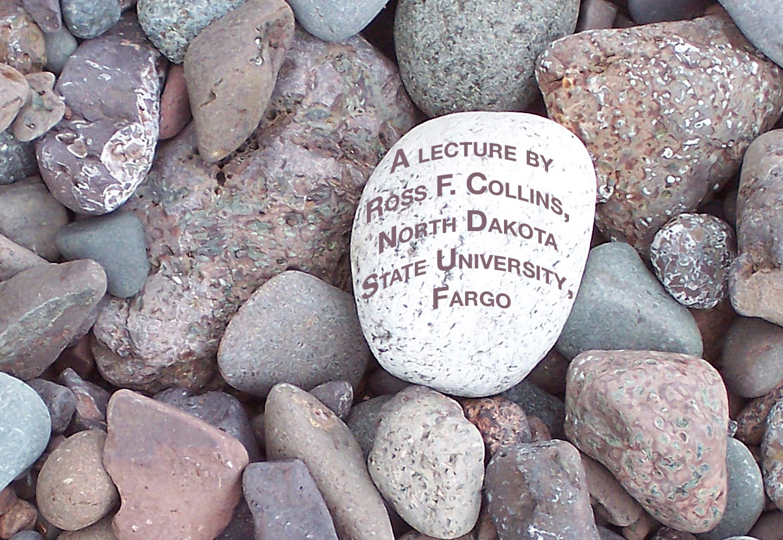
What is
a digital SLR (DSLR)?

Slide 2
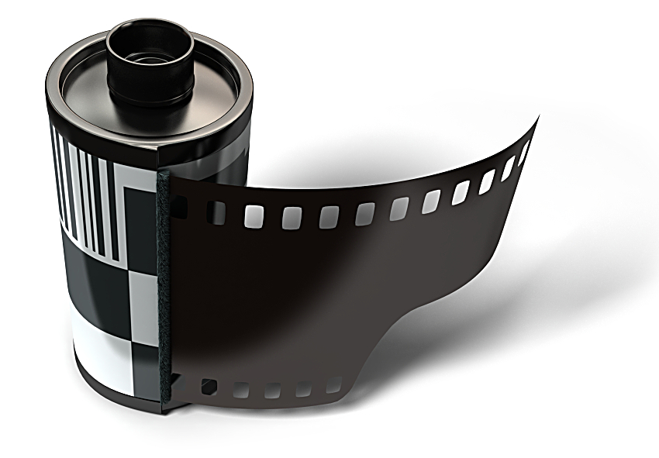
Before DSLRs
Cameras for more than 150 years took photos using chemical-based ingredients.
Those ingredients changed radically over the years.
Coated metal plates.
Coated glass plates.
Coated flexible strips. We used to call this “film.”

Slide 3
Film
But even film changed a lot since its development in 1888.
It used to be larger, but kept getting smaller, until by the 1970s 35mm became the standard.

Slide 4
The SLR
In the 1960s the quest was to build a practical camera that allowed you to actually take see what the camera lens saw.
Before that a viewfinder showed only an approximation.

Slide 5
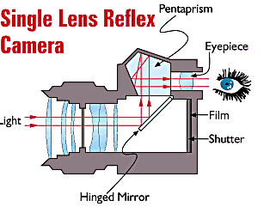
The SLR
The Single Lens Reflex, or SLR, allows you to do that.
A series of mirrors in front of the film or sensor reflect the light coming through the lens into a pentaprism viewfinder.
When you press the shutter, the mirror flips up to take the picture—instantaneously.

Slide 6
DLSRs
The digital version usually works the same way. It’s considered better than the “rangefinder,” because you see exactly what you get.
Digital point-and-shoot cameras and smartphones usually provide a viewfinder through an LCD display screen. This exposes the sensor constantly to light.
Sometimes these cameras also have an optional eyepiece.
Professionals do not use the LCD displays generally to frame photos, instead preferring the more precise optical eyepiece.

Slide 7
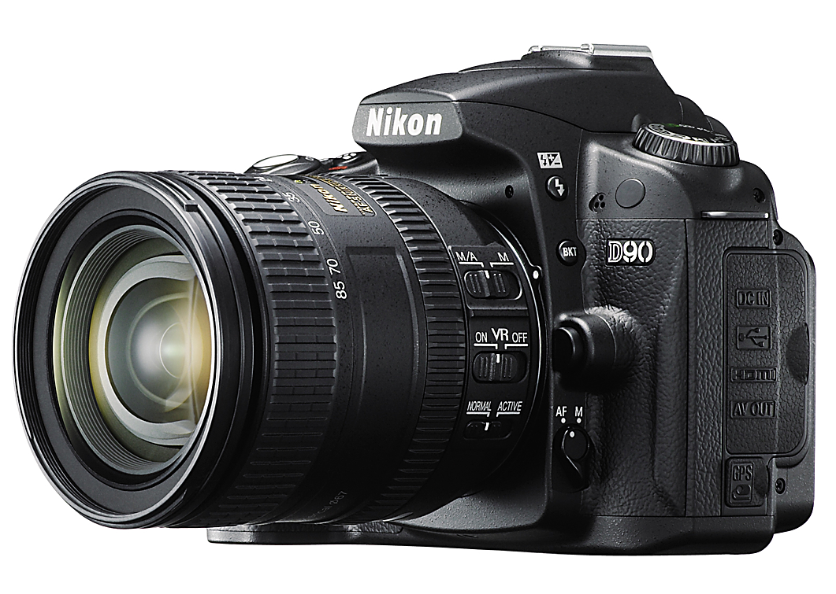
DSLR categories
DSLRs can be divided into three ranges:
entry level.
midrange.
professional.
What’s the difference?

Slide 8
Entry-level DSLRs
These include features of a compact, or point-and-shoot camera for beginners.
An all-purpose “kit” lens.
Exposure options or “image modes” for different settings.
An auto program. The auto program generally has manual overrides for photographers who wish to control their exposures.
A small pop-up electronic flash.
Traditionally a lower megapixel capacity, about 10-12 megapixels, although the newest models have boosted that to up to 18 megapixels.

Slide 9
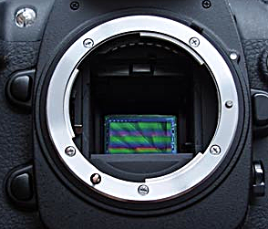
Megapixels
Manufacturers like to publicize their megapixel numbers as equivalent to quality.
But it’s not only the megapixel size. It’s the sensor size.

Slide 10
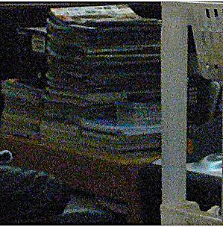
Cramming pixels
You can add more pixels, but if the sensor size is small, the only way to get them in is to make them smaller and closer together.
This makes the sensor more sensitive to light. But it also increases the noise.
Noise is that unattractive grainy look in digital photos. It used to be called “grain” in film.

Slide 11
Sensors
So the answer to high quality photos is actually a bigger sensors.
That’s the advantage of the higher-end DSLRs.

Slide 12
Sensor size
Compact “point-and-shoot” cameras usually have tiny sensors, about 9mm by 6mm.
Low-end and midrange DSLRs have sensors of around 28mm by 15mm.
High-end DSLRs have sensors about the same size as 35mm film, 36mm by 24mm, called “full-frame sensors.”

Slide 13
Mid-level DSLRs
These have larger sensors, larger buffer sizes, tougher materials, more exposure options.
They cost over $1,000, usually, with the kit lens.
Buffering temporarily saves the image information in RAM until it can be written to the storage card. Large buffers mean you can take more photos faster.

Slide 14
Pro-level DSLRs
These are rugged, full-frame sensor cameras, and include other features pros want.
They’ll probably cost $2,000 and up.
Pro-standard cameras, however, don’t generally come with the features of the low-end models. No built-in flash, no scene modes. It’s simple, fast, and takes superior photos—for the pro who knows what she/he is doing and doesn’t need gadgets.

Slide 15
Camera RAW
Another feature of DSLRs is the ability to store images in RAW format.
JPEG format color corrects, sharpens and compresses the image information and so takes some control away from the photographer.
RAW records image directly as the sensor sees it, without processing.
The photographer does the processing in Photoshop.

Slide 16
RAW format
RAW produces superior images. Why? It allows photographers to use all the digital information gathered by the sensor.
Sensor elements are called photosites.
Photosites collect light and convert to electrical charge.
Electrical charge is converted to digital signal.
Sensors, however, don’t collect color—just light and dark.

Slide 17
RAW format
The color is produced using the additive color mixing system’s three primaries: RGB.
Three filters are used: R to collect one-fourth of pixels, G to collect one-half, and B to collect the other one-fourth.
So if you have an 8 megapixel camera, divide 8 by ¼=2. You get 2 megapixels with red, 2 with blue, 4 with green.

Slide 18
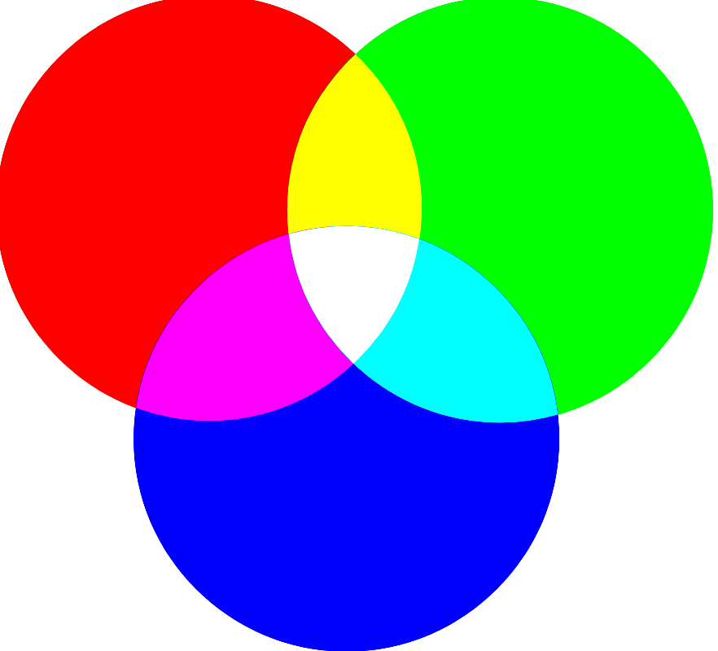
RAW format
Why double the green?
The human eye is most sensive to green light, so that color is boosted so the picture looks more natural.
The camera’s software interprets these pixels for each filter to color intensities, and produces the full-color image.
Note that color film actually did it the same way, using three filters chemically instead of electrically.

Slide 19
Other DSLR features
Here are a few other often-used features you can find on DSLRs:
ISO control.
White balance control.
Metering style control.
Auto/manual focus control.
Flash exposure control.
Aperture/shutter speed priority control.
Interchangable lenses, wide-angle to telephoto.
Self-timer/muliple exposure control.

Slide 20
Know your camera
For our camera show-and-tell class, you’ll need to study your instruction manual to learn more about your camera’s features.
In particular, I will ask you about the features on the above list.
Your knowledge of what these features are and how they work based on the manual will determine your grade for this project.
If you can’t find the manual, most can be downloaded from the manufacturer’s website.

